Slide 1

Hypothesis Testing and ANOVA

Slide 2
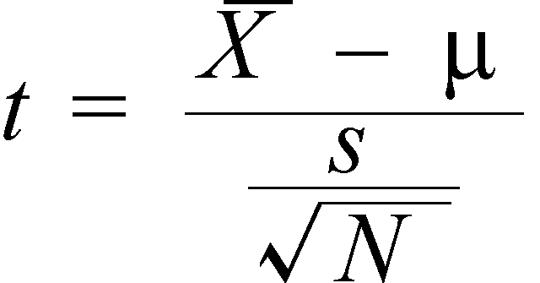
Hypothesis Testing – One Sample t-test
Hypothesis Testing typically begins with theory, claim or assertion about population parameter.
Hypothesis is nothing but assumption which we make about your population parameter (mean). And we need to test that assumption to reach conclusion – called as “Hypothesis Testing”.
The term “t-test” stands for “t distribution” for hypothesis testing. It can be use if we have sample standard deviation and sample mean.

Slide 3
Hypothesis Testing – One Sample t-test
As a Operational Manager of “Oxford Cereal Company”, you are in charge of monitoring the amount of cereal contained in boxes. You are concerned with evaluating whether or not the cereal-filling process is working to ensure that on average, 368 grams of cereal in each box.
A random sample of 25 boxes are selected and calculated the weight of each 25 boxes and then calculate the mean weight of 25 boxes to determine how close the mean weights are to 368 grams.
You hope that process is working properly, but sampled boxes may contain too little or too much cereals. As a result, you may want to halt the production process until you find the reason of failure.
If you find no difference, no corrective action is needed else you need to take corrective actions.

Slide 4
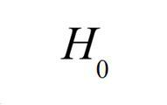


Hypothesis Testing – One Sample t-test
The Null and Alternate Hypothesis: The hypothesis that the population parameter is equal to some assumed value is refer to “Null Hypothesis” The null hypothesis is always a notified as “no difference” and is denoted by symbol
For Example: = 368
Null Hypothesis is always written in terms of population. The sample statistics will be used to make inference.
One of the possibility is “null hypothesis is false”. If null hypothesis is false then something else must be true. And it is Alternative Hypothesis. It is denoted as
For Example: = 368

Slide 5
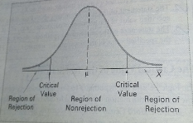
Hypothesis Testing – One Sample t-test
Critical Value of t-Test: Critical values for a test of hypothesis depend upon a test statistic, which is specific to the type of test, and the significance level (alpha). For example, you set value of alpha = 5% means that you are (100%-alpha) or 95% confidence that your null hypothesis is true and 5% not.
Critical Value divide
the distribution in
terms of rejection
region and non –
rejection region.

Slide 6
Hypothesis Testing – One Sample t-test
Rule for Decision Making:
reject the null hypothesis if the test statistics (t-test) value falls in area of rejection,
otherwise do not reject the hypothesis.
Risk in Decision Making: Every decision involves risk based on our assumption.
Type I Error: occurs if the null hypothesis is rejected when in fact it is true. It is nothing but the alpha value which we have agreed on. If alpha is set to 5% then, there is 5% probability of falsely rejecting the hypothesis in fact it is true.
Type II Error: occurs if the null hypothesis is not rejected when in fact it is false.
We can control above error either by fixing alpha and by fixing the sample size.

Slide 7
Hypothesis Testing – One Sample t-test
Concept of p-value: There is another way to decide whether to reject the null hypothesis or not to reject it. p-value is the probability of obtaining test statistics equal to or more extreme than result obtained from the sample data, if the null hypothesis is true.
It is the probability of obtaining the difference between sample (mean) and hypothesized value.
For example: if H0 = 368 and p-value = 0.004 and sample mean = 324 then there is 0.4% probability of obtaining a difference of 4 unit, if the null hypothesis is true. This value is compare to alpha (say 0.5)
Reject the H0, if p-value < alpha
Do not reject the H0, if p-value >= alpha

Slide 8
Hypothesis Testing – One Sample t-test
In one of the efforts to maintain the internal control of sales, Saxon Plumbing Company collects the sample of sales invoices at the end of the month to evaluate the mean amount listed on the sales invoices for the warehouse. Over the past five years, the mean amount per sales invoice for customers is around $120.
Based on the experience of Saxon Plumbing Company, you make assumption that mean amount of sales invoice is $120. As an auditor, you need to check whether this assumption or hypothesis is statistical significant or not.
To start, you take random sample of 12 invoices and check for the mean difference.

Slide 9

DEMO

Slide 10

Hypothesis Testing – Two Sample t-test
In this slide, hypothesis testing is extended to procedures that compare the statistics from two sample of numerical data drawn from two populations.
For two sample t-test, we need to check whether the variance between the two populations are equal or not. Different algorithm has been used for calculating test statistics when the variance is equal and variance is not equal.
We can check the above assumption of equality of variance by using F-Test. F-Test is nothing but the ratio of two variance as follow.

Slide 11
Hypothesis Testing – Two Sample t-test
The null hypothesis for the F-Test is two population variance are equal and the alternative hypothesis is two population variance are not equal.
Based on the result of p-value for F-Test, we need to decide whether to use the equal or pooled variance t-test or separate variance t-test.
Both the types of tests are a part of output of proc ttest by default if you use the two sample t-test.

Slide 12
Hypothesis Testing – Two Sample t-test
As a regional sales manager of BLK Foods, you are interested to comparing the sales volume of BLK Cola when the soft drink is displayed in the normal shelf location as compared to an end-aisle promotional display.
To select the effectiveness of end-aisle displays, you select 20 stores from BLK supermarket chain that all experience similar sales volumes.
You then randomly assigned 10 of the 20 stores to group1 and group2 The manager of the 10 stores of group1 place the BLK Cola in the regular shelf location. The manager of the 10 stores of group2 uses the special end-aisle promotional display. At the end of the week, sales of both the groups are recorded.
How would you use this information to improve the sales of BLK Cola?

Slide 13
DEMO

Slide 14
Hypothesis Testing – Paired t-test
Sometimes, two groups are not independent meaning that the result of one group is not independent of result of second group.
This dependency characteristic of the two groups occurs either because the items or individuals are paired or matched according to some features or because repeated measurements are obtained from same set of items or individuals.
In either case, it requires different procedure/algorithm to accommodate dependency feature of two samples.

Slide 15
Hypothesis Testing – Paired t-test
First Approach Example: In test marketing, a product under two different advertising and promotional strategies. A sample of test markets can be matched on the basis of test market population size and/or other socioeconomic and demographic variables. By controlling these variables, one is better able to measure the effect of two different advertising and promotional campaigns.
Second Approach Example: The same item or individual will behave alike if treated alike. The objective of the analysis is to show that any differences between two measurements of the same items/individuals are due to different treatment condition. For example, how much time it takes to complete the projects based on timelines.

Slide 16
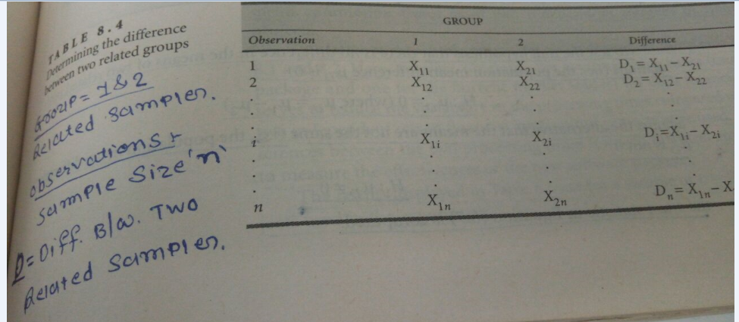
Hypothesis Testing – Paired t-test

Slide 17
Hypothesis Testing – Paired t-test
Null Hypothesis for two paired samples:
H0: uD = 0 where uD = u1 - u2 OR
H0: uD1 = uD2
Alternative Hypothesis for two paired samples:
H1: uD Not Equal to 0 OR
H1: uD1 Not Equal to uD2

Slide 18
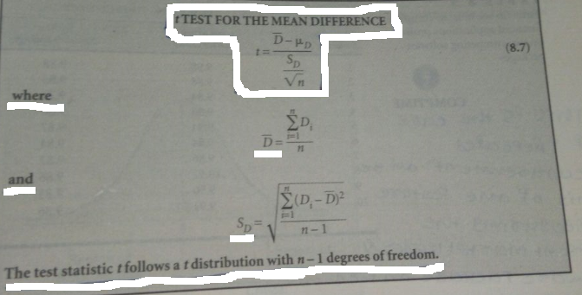
Hypothesis Testing – Paired t-test

Slide 19
Hypothesis Testing – Paired t-test
A software applications company is developing a new financial applications package. Because the computer processing time is an important decision criterion, the developer wants the new package to have the same feature and capabilities as the current market leader while providing results faster than the current leading package.
An experiment is undertaken to execute the financial applications projects by using new package and current market leader and average processing time required to get the similar results are recorded.
Is there any significant mean difference between current market leader package and new package?

Slide 20
DEMO

Slide 21
One Way ANOVA Modelling
Analysis of Variance (ANOVA) is a statistical technique used to compare the means of two or more groups of observations or treatments. For this type of problem, you have the following:
- a continuous dependent variable/response variable
- a discrete independent variable/predictor variable
If you analyze the difference between two groups using ANOVA, you reach the same conclusion as we did by using proc ttest.
But what if, if we have n number of groups. We can not compare all the groups one by one. Rather there should be algorithm which analyze the data simultaneously. ANOVA gives us this kind power to compare the means of n number of groups.

Slide 22
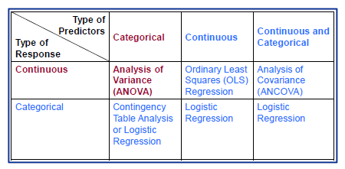
One Way ANOVA Modelling

Slide 23
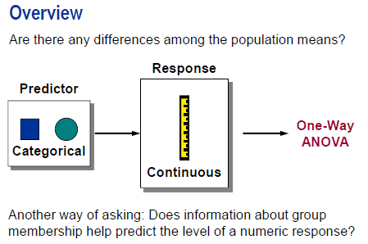
One Way ANOVA Modelling

Slide 24
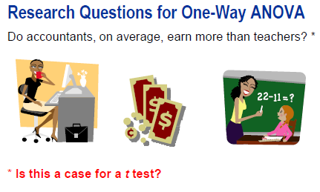
One Way ANOVA Modelling
If you analyze the difference between two means using ANOVA, you reach the same conclusions as you reach using pooled, two-group t-test. Performing a two-group mean comparison in PROC GLM gives you access to different graphical and assessment tools than performing the same comparison in PROC TTEST

Slide 25
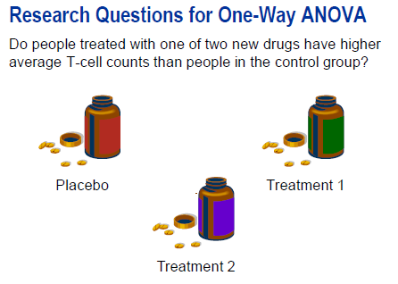
One Way ANOVA Modelling
When there are three or more levels for grouping variable, a simple approach is to run a series of t-tests between all the pairs of levels. For Example, you might be interested in T-cell counts in patients taking three medications (including one placebo).
You could simply run a t-test for each pair of medications. A more powerful approach is to analyze all data simultaneously. The mathematical model is called “one way analysis of variance (ANOVA)”, and the test statistics F ratio, rather than student’s t-test.

Slide 26
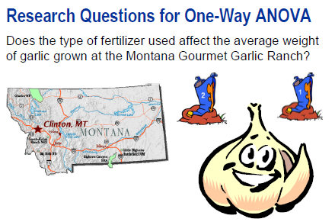
One Way ANOVA Modelling

Slide 27
One Way ANOVA Modelling
Montana Gourmet Garlic is a company that grows garlic using organic methods. Knowing a little about experimental methods, the owners design an experiment to test whether growth of garlic is affected by the type of fertilizer used.
They limit the experimentation to a Rocambole variety named Spanish Roja, and test three organic fertilizers and one chemical fertilizer (as a control).
They blind themselves to the fertilizer by using containers with numbers 1 through 4. (In other words, they design an experiment in such a way that they do not know which fertilizer is in which container.)
One acre of farmland is set aside for the experiment. It is divided into 32 beds. They randomly assign fertilizers to beds. At harvest, they calculate the average weight of garlic bulbs in each of the beds.

Slide 28
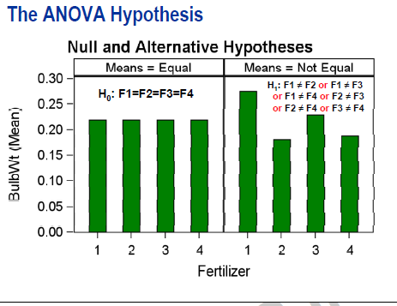
One Way ANOVA Modelling

Slide 29
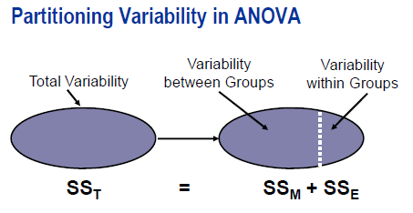
One Way ANOVA Modelling

Slide 30
One Way ANOVA Modelling
As its name implies, Analysis of Variance analyzes or breaks apart, the variance of the response variable to determine whether the between the group variation is the significant portion in total variation.
We can check this by using F-Test.
F-Test is the ratio of the Model Variance and Error Variance.
The whole process explained in previous slides starts with Sum Of Squares. There are three sum of squares – Model Sum of Square (Between the Group Variation), Error Sum of Squares (within the group variation) and Total Variation.

Slide 31
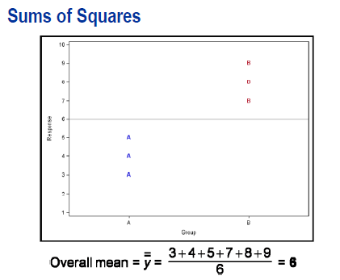
One Way ANOVA Modelling

Slide 32
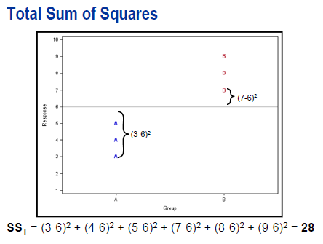

One Way ANOVA Modelling

Slide 33
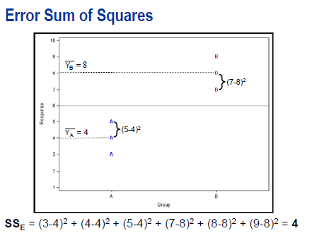
One Way ANOVA Modelling

Slide 34
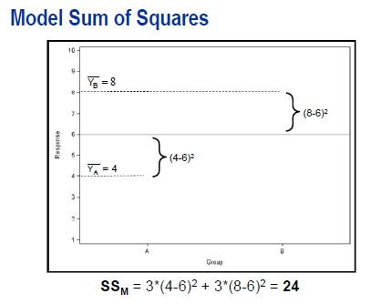

One Way ANOVA Modelling

Slide 35
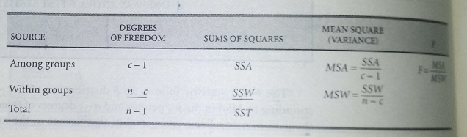
One Way ANOVA Modelling
The null hypothesis of ANOVA is tested using F statistics as follow:

Slide 36
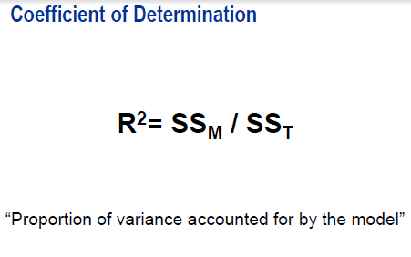
One Way ANOVA Modelling

Slide 37
One Way ANOVA Modelling
The coefficient of determination, is a measure of the proportion of variability explained by the independent variables in the analysis.
The value of R-square is between 0 to 1. The value is
close to 0 if independent variables do not explained variability in the data.
close to 1 independent variables explain a relatively large proportion of variability in the data.

Slide 38
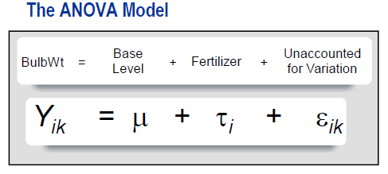
One Way ANOVA Modelling

Slide 39
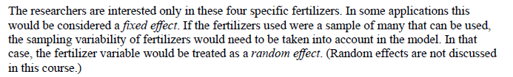
One Way ANOVA Modelling

Slide 40
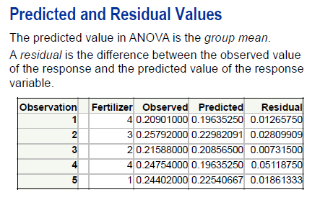
One Way ANOVA Modelling

Slide 41
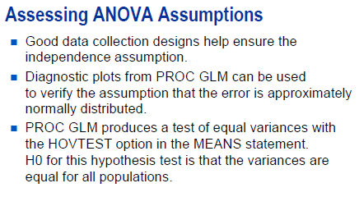
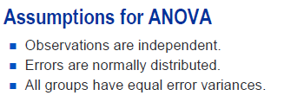
One Way ANOVA Modelling
The validity of p-value depends on the data meeting assumptions of ANOVA. Therefore, it is good practice to verify those assumptions in the process of analyzing the group differences.

Slide 42
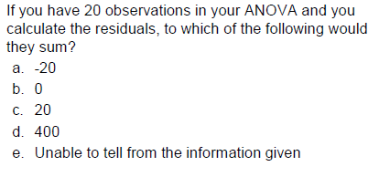
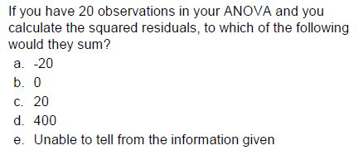
One Way ANOVA Modelling

Slide 43
One Way ANOVA Modelling
As a marketing manager of Sobeys Inc., you are responsible to examine the sales volume across different categories. Suppose, out of the different categories available, you pick up the sales of electronic items and measure its sales volume across the regions.
Based on the data collected from sample, you need to check whether sales volume across the regions are same or different.
How will you use the above information to frame the different marketing strategies.
Do you think, you will perform the multiple t-tests to analyze the difference or you use the ANOVA?

Slide 44
DEMO

Slide 45
ANOVA Post Hoc Studies
Once we know, there is a significant effect of independent variable, the next step is to perform all pairwise comparison of difference in the treatment means.
We can perform such kind of Post Hoc Studies by using graphical features of PROC GLM.
A pairwise comparison examines the difference between the two treatment means. “All Pairwise comparisons” means all possible combinations of two treatment means.
Tukey’s multiple comparison adjustment is based on conducting all pairwise comparisons and guarantees that TYPE I experimentwise error rate is equal to alpha for this situation.

Slide 46
DEMO

Slide 47
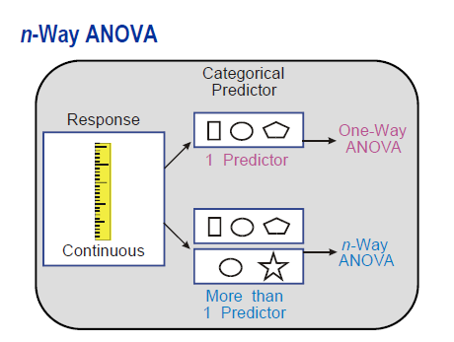
Two-Way ANOVA Modelling
We have seen earlier that most of the variation in response variable to be explained by only one predictor variable. However, there can be more than one predictor variable explaining the variations in response variable.

Slide 48
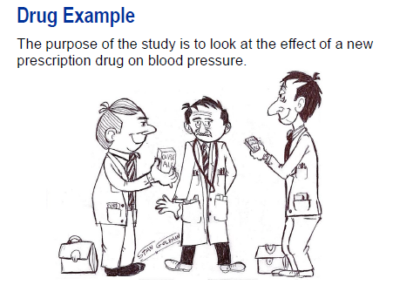
Two-Way ANOVA Modelling

Slide 49
Two-Way ANOVA Modelling
The Dataset contains the following variables:
- Drugdose: Dose level of drugs (1, 2, 3, 4) corresponding to (Placebo, 50mg, 100mg, 200mg)
- Disease: Heart disease category
- BloodBP: Change in diastolic blood pressure after 2 weeks treatment.
Data were collected in an effort to determine whether different dose levels of a given drug have an effect on blood pressure for a people with different heart diseases. In other words, is there any difference in blood pressure change across the levels of drug dose and diseases.

Slide 50
DEMO

